Slide 1
Analyzing Automobile Sales Trends, Insights, and Patterns
Student Name : Rohan Ashok Gonabal
Course 6 : Exploratory Data Analysis Using Tableau
Batch Code : DA464S46
Project Guide : Komilla Bhatia

Slide 2
Problem Statement
The company lacks a unified understanding of sales trends, customer behavior, product performance, and inventory efficiency. This leads to missed sales opportunities, poor stock management, inefficient order fulfillment, and suboptimal pricing strategies. A comprehensive data-driven analysis is needed to improve forecasting, segmentation, and decision-making across all areas.

Slide 3
Objectives
Identify sales trends, peak periods, and declines across time, products, and regions.
Group customers by behavior and preferences to improve targeted strategies.
Predict future sales to support better planning and decisions.
Evaluate top-performing, low-performing, and seasonal products.
Balance stock with demand and optimize reorder levels.
Assess order processing efficiency and spot delays or issues.
Analyze pricing impact on sales and suggest profitable strategies.

Slide 4
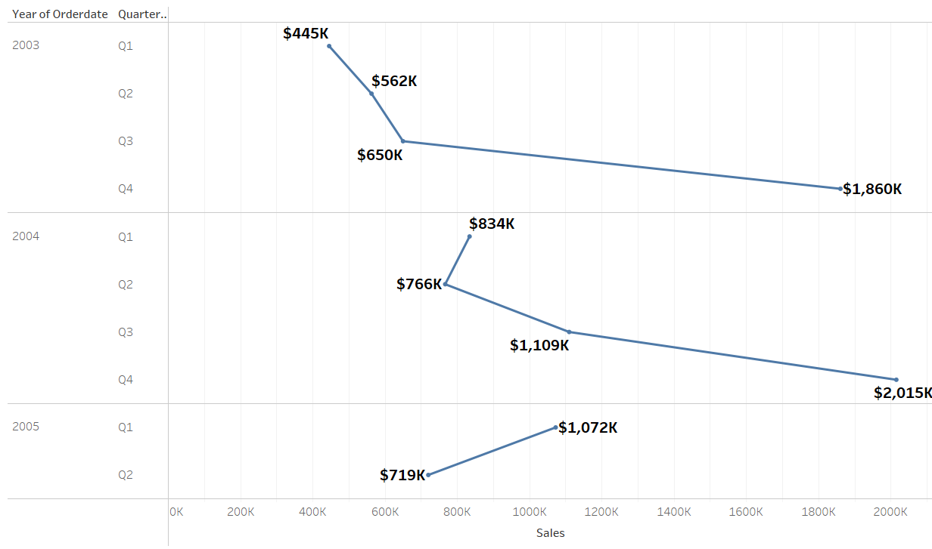
Sales Data Analysis
1. Sales over Years and Quarters
Interpretation:
From 2003 to 2005, Quarter 1 had the highest sales each year: $445k (2003), $834k (2004), and $1.072k (2005).
Sales dropped in Q2–Q4, with Q2 lowest in 2005 and similar declines in 2003 and 2004.

Slide 5
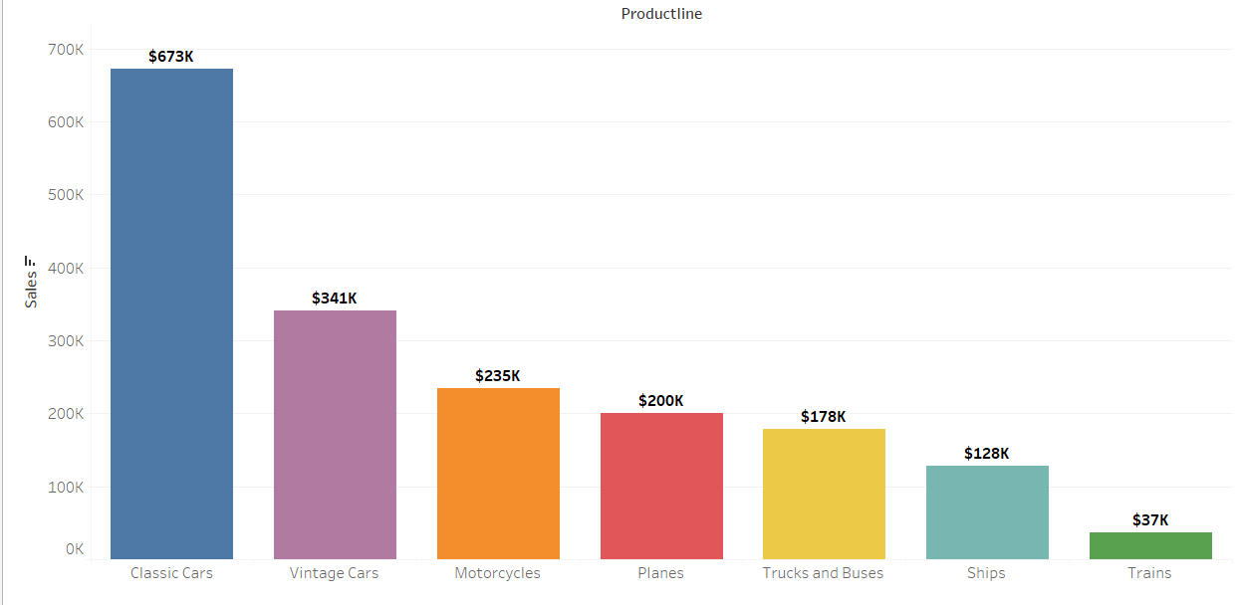
Sales Data Analysis
2. Total Sales by Product Line
Interpretation:
In the Product line, we have the highest sales in Classic Cars of $6,730,000.

Slide 6
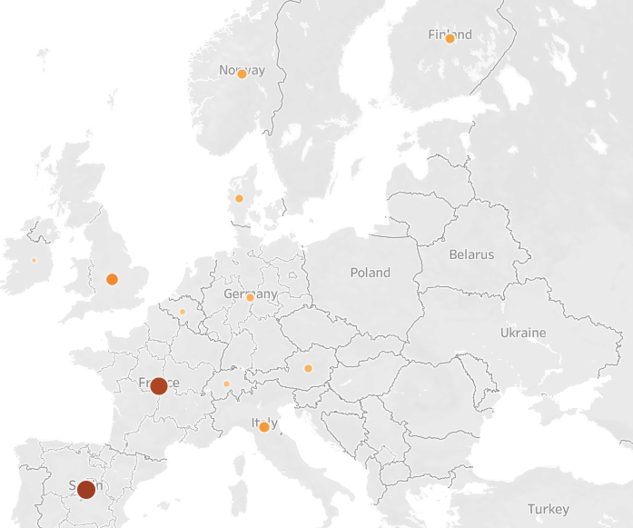
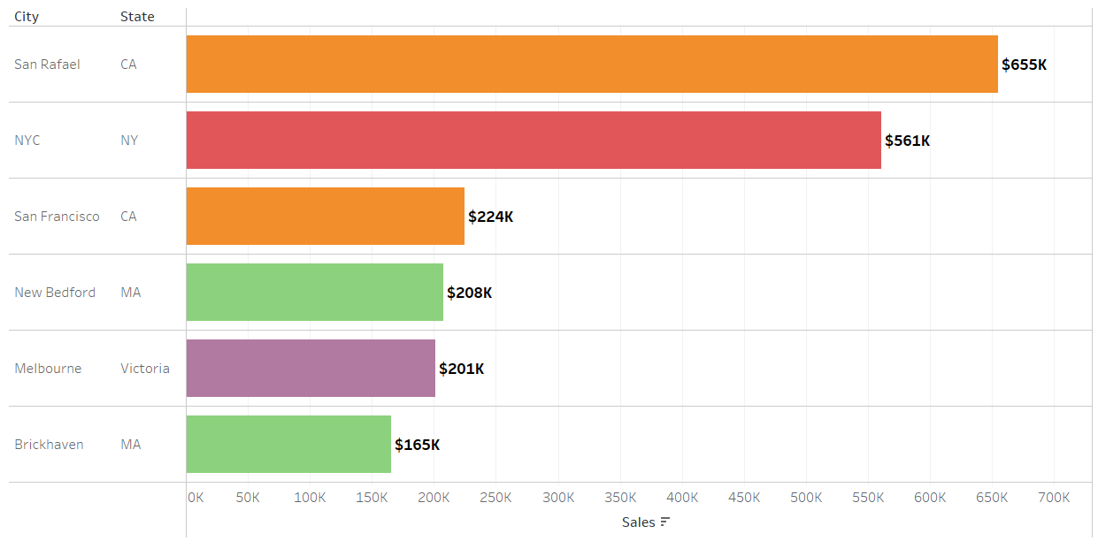
Customer Segmentation Analysis
1. Customer distribution in each country
2. Total Sales by City and State
Interpretation:
France has the Highest Sales Across Other territories.
Interpretation:
San Rafael in CA State has the Highest Sales.

Slide 7
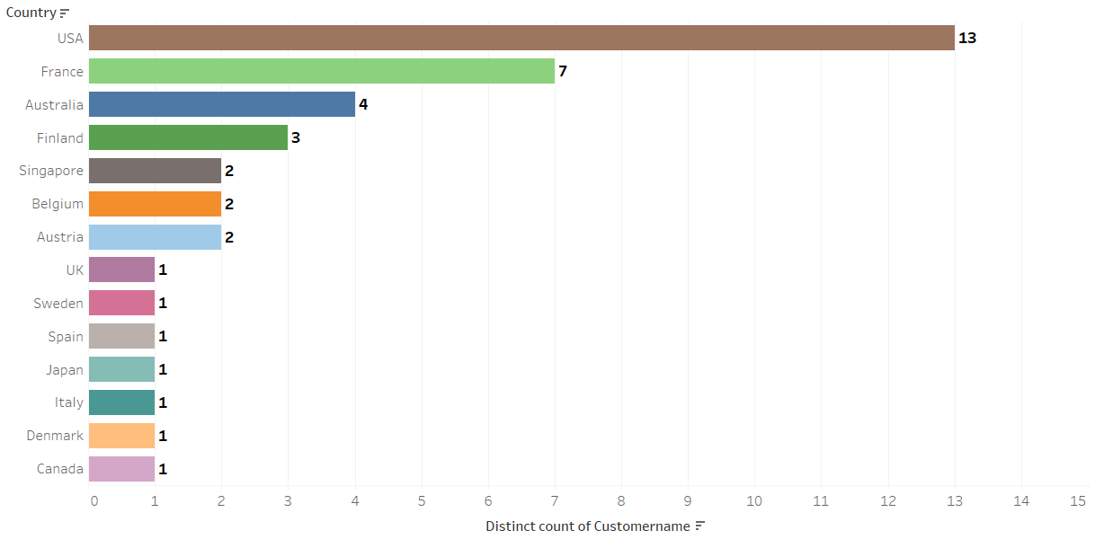
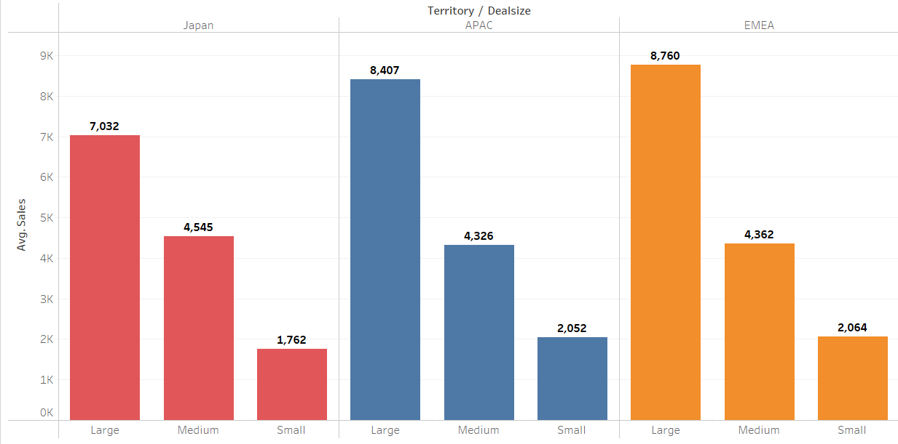
Customer Segmentation Analysis
3. Total Sales by Territory and Country
4. Average Sales By Deal Size
Interpretation:
The USA has the Highest customer distribution.
Interpretation:
Japan has the Highest average sales Across All territories..

Slide 8
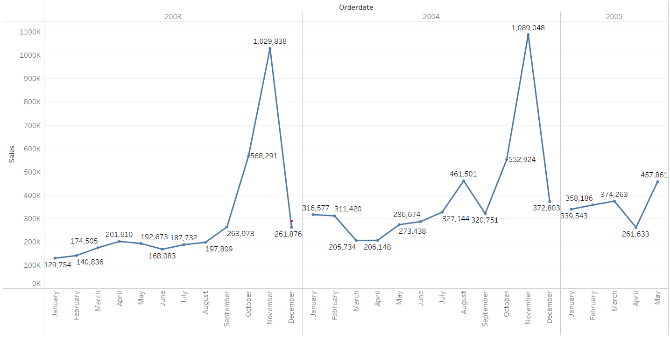
Sales Forecasting
1. Total Sales by Year and month
Interpretation:
Sales rose from January to November in 2003 and 2004, then dropped in December; May 2004 had the peak.

Slide 9
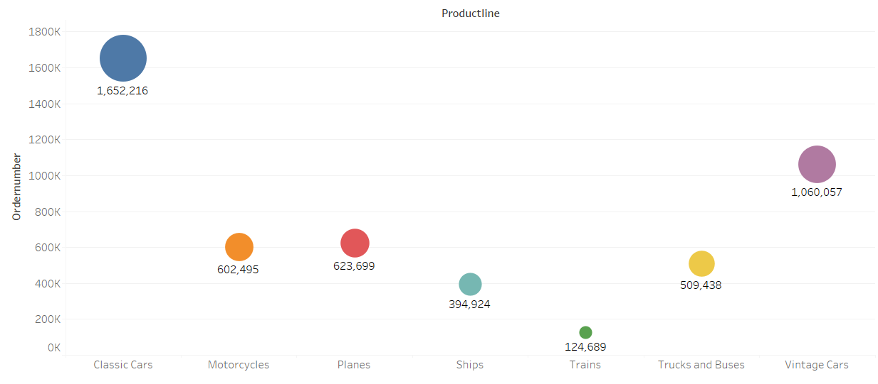
Product Performance Analysis
1. Highest and lowest quantities ordered by Product Line
Interpretation:
The highest orders are from classic cars of 1,652,216, and the lowest orders are from trains of 1,24689

Slide 10
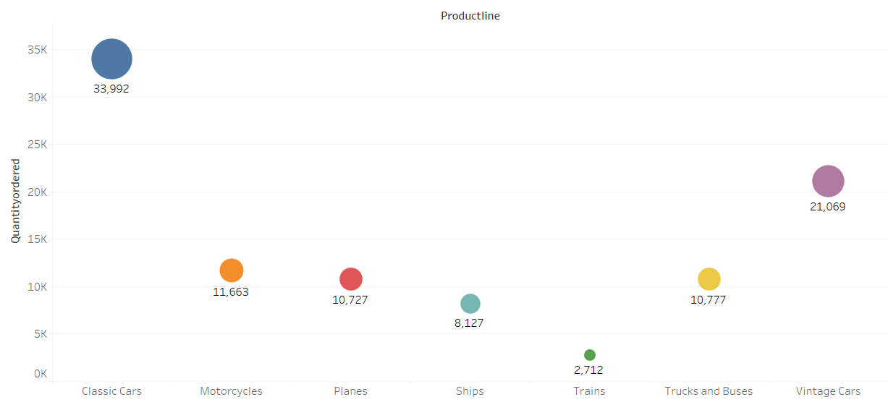
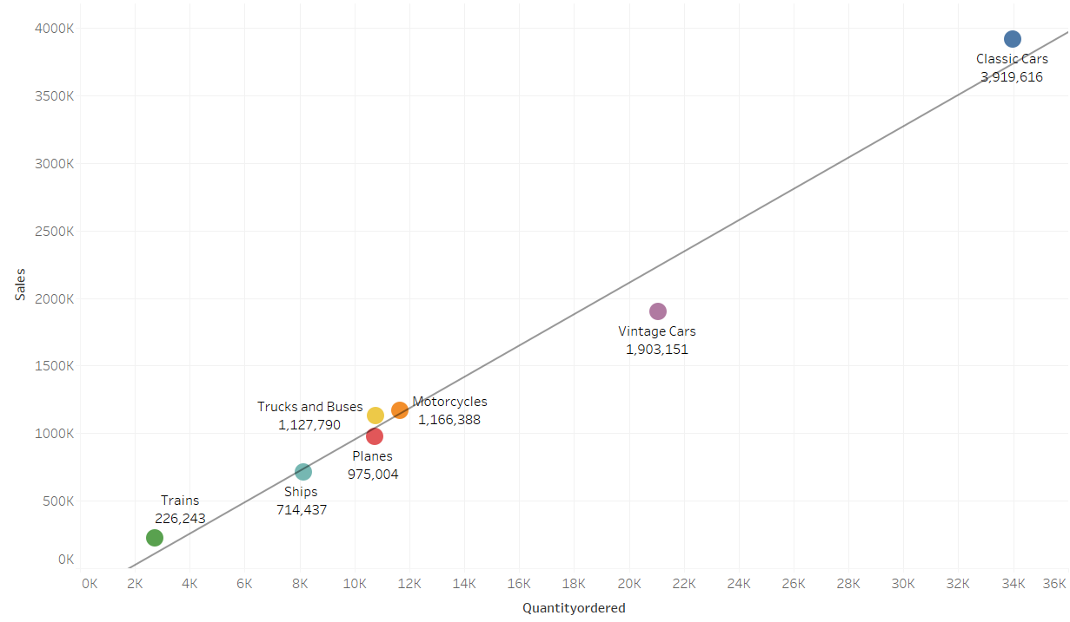
Inventory Management Analysis
1. Maximum & Minimum Quantity Ordered
2. Comparing sales and Quantity ordered
Interpretation:
Classic has the Highest orders Across Other ProductLine.
Interpretation:
Classic has a positive correlation with order quantity.

Slide 11
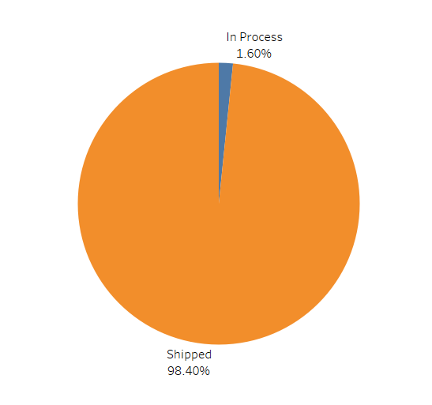
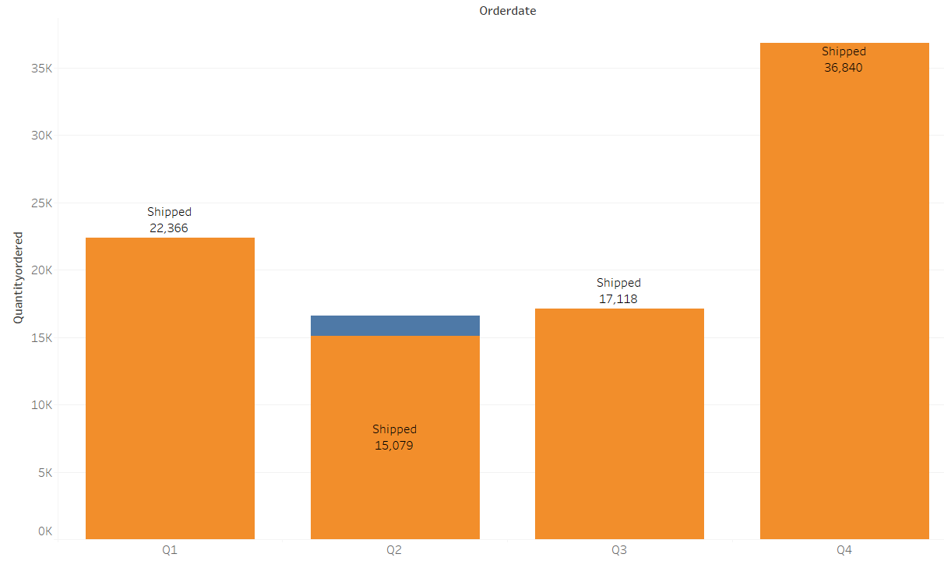
Order Fulfilment Analysis
1.Distribution of order status
2. Order status over different Quarters
Interpretation:
Orders Shipped is 98.40%.
Interpretation:
Highest orders shipped in Quarter 4.

Slide 12
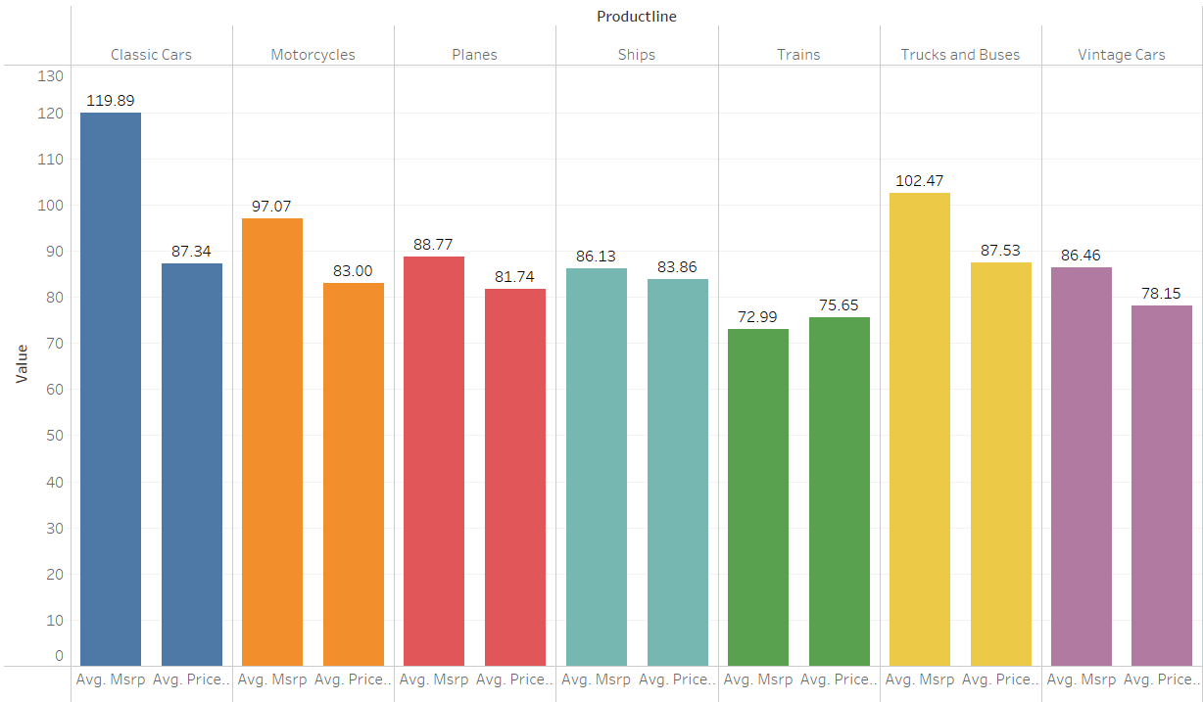
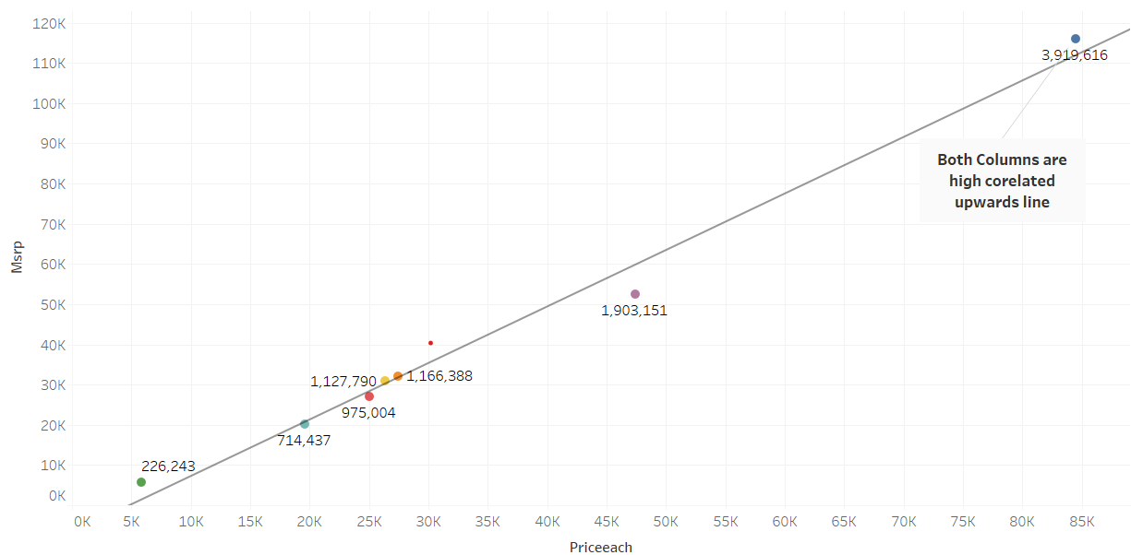
Pricing Strategy Analysis
1. Average Based On MSRP and Each Price
2. Comparing On MSRP and Price Each
Interpretation:
Classic has the Highest Average values.
Interpretation:
Classic has a positive correlation with order quantity.

Slide 13
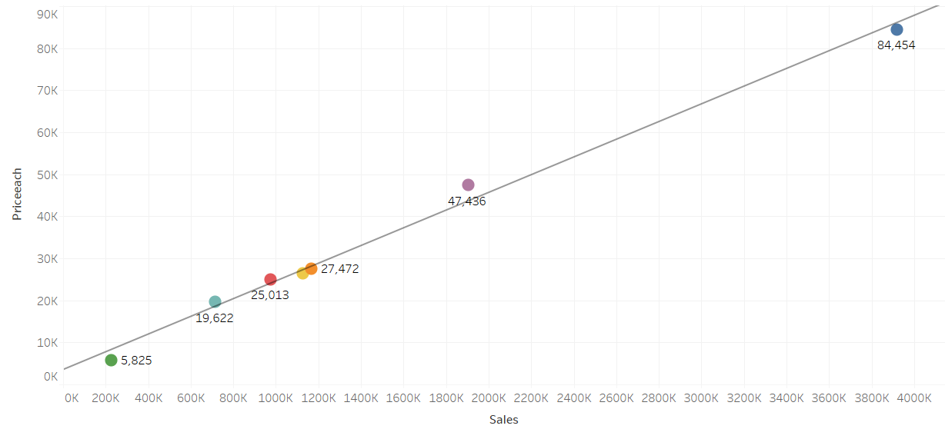
Pricing Strategy Analysis
3. Comparing Sales Based On Each Price
Interpretation:
Positive correlation between sales and each price.

Slide 14
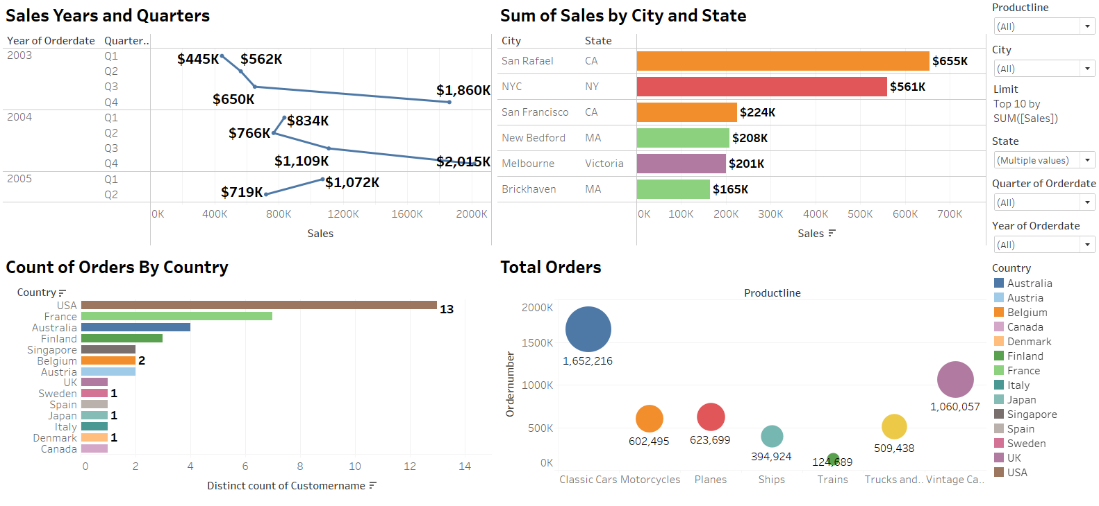
Sales and Customer Segmentation Analysis Dashboard

Slide 15
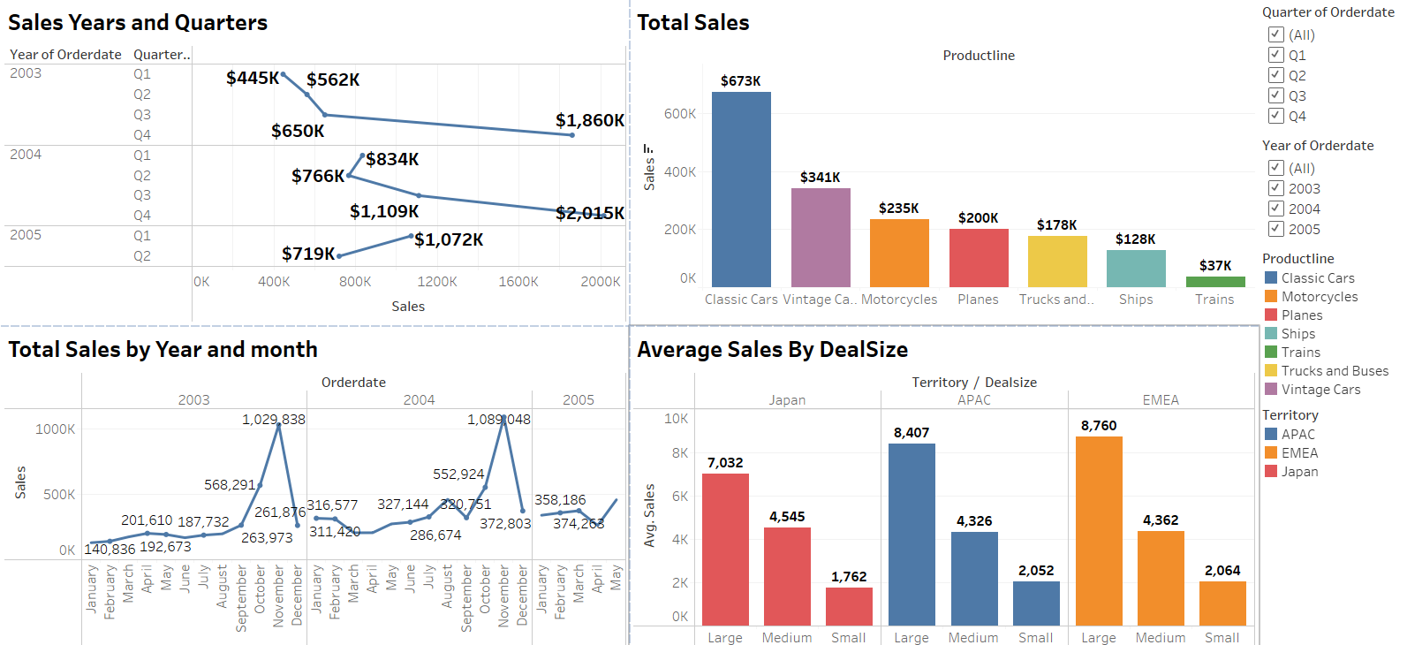
Sales Forecasting Analysis Dashboard

Slide 16
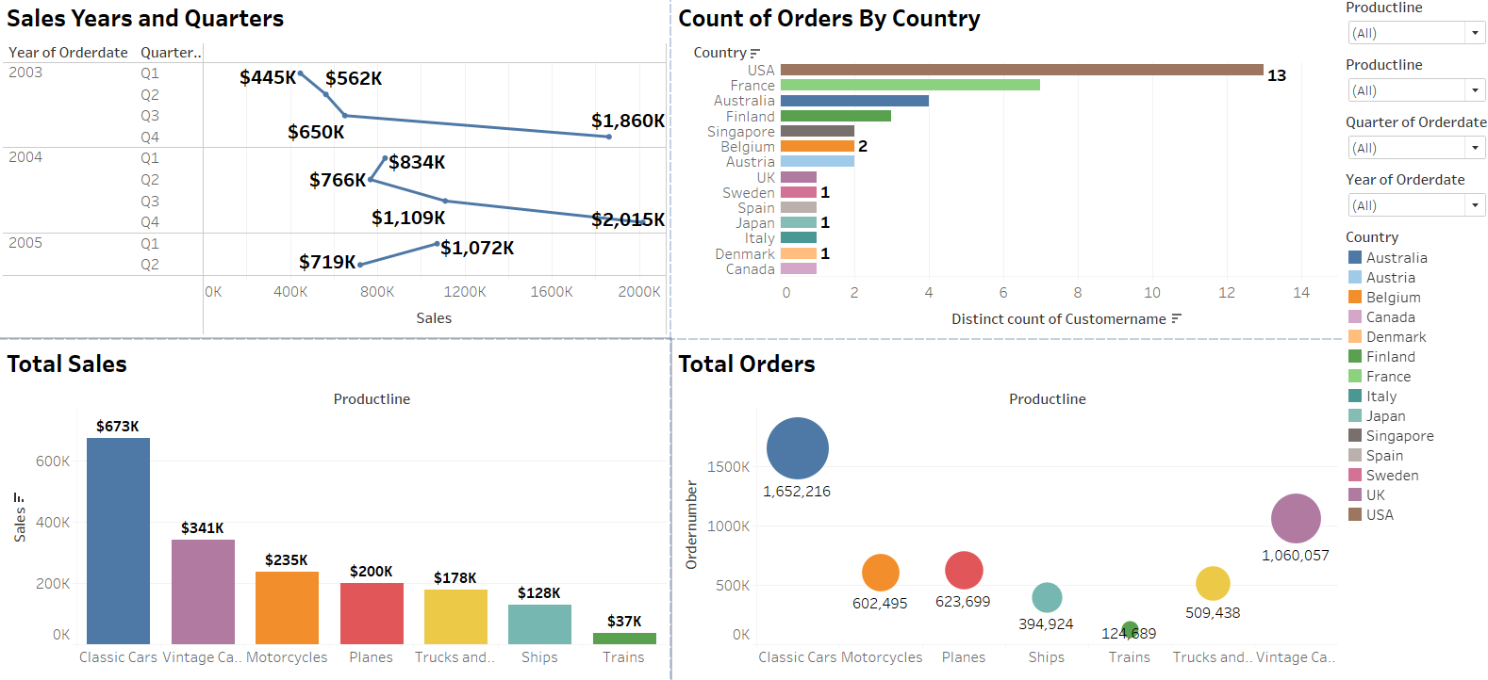
Product Analysis Dashboard

Slide 17
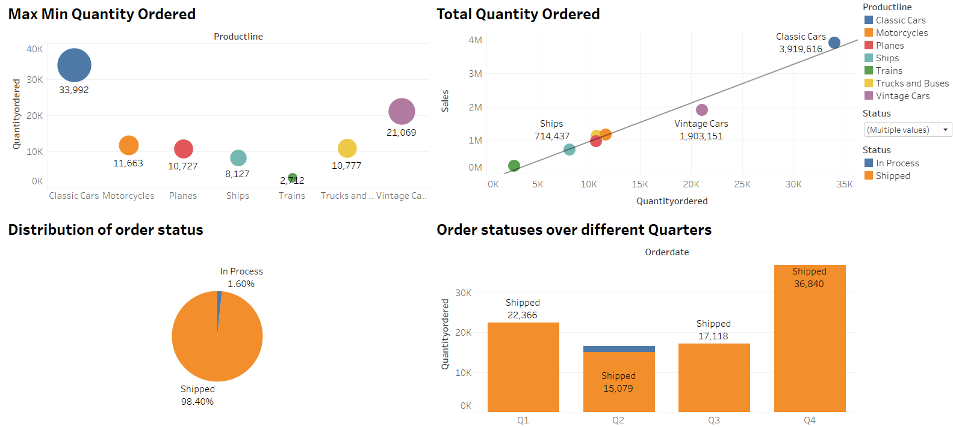
Stock and Orders Dashboard

Slide 18
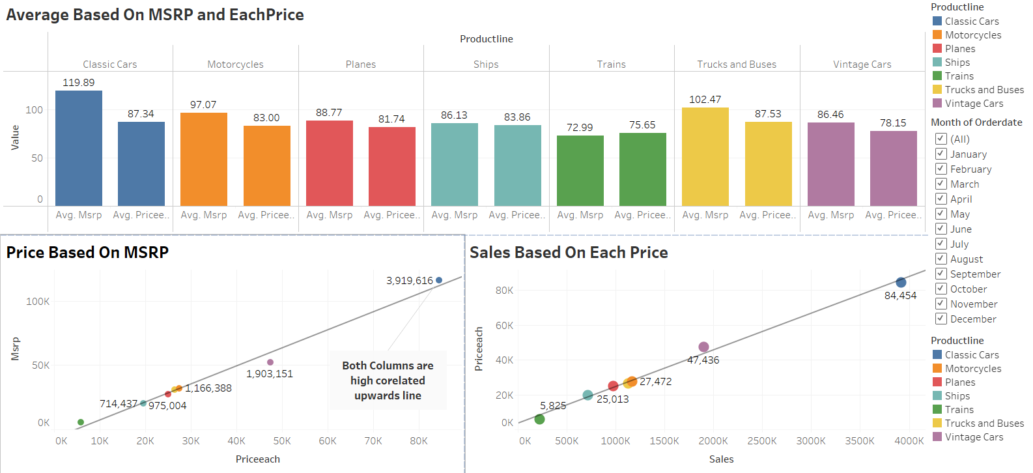
Pricing Strategy Dashboard

Slide 19
SUMMARY
Identify trends, peak periods, and declines across products, regions, and time.
Group customers by behavior and preferences for targeted marketing.
Predict future sales to support accurate planning and inventory decisions.
Evaluate which products sell well or underperform, including seasonal trends.
Maintain optimal stock levels to avoid overstocking or shortages.
Assess order processing efficiency and identify delays or issues.
Analyze the impact of pricing on sales and recommend profit-driven strategies.

Slide 20
Conclusion
Quarter 1 consistently recorded the highest sales across all three years.
Sales grew steadily from 2003 ($445k) to 2005 ($1.074M) in Q1.
Quarters 2 to 4 showed significantly lower performance, especially Q2 in 2005.
Classic Cars emerged as the best-selling category, with a total of $6.73 million in sales.
Classic Cars also received the highest number of orders (1,652,216), confirming strong market demand.
Trains recorded the lowest number of orders (124,689), indicating low product movement.
France led sales across various territories.
Within the U.S., San Rafael (California) had the highest city-level sales.

Slide 21
Conclusion
The USA had the highest customer distribution, showing strong brand reach
The order fulfillment rate was high at 98.40%, reflecting strong operational performance.
Quarter 4 saw the highest volume of shipments, possibly due to holiday season demand or year-end bulk orders.
Classic Cars demonstrated a positive correlation between order quantity and average value, reinforcing their top-performing status.
A positive correlation between sales and price across products suggests that higher-priced items continued to sell well, possibly due to perceived value or brand strength.

Slide 22
THANK YOU

